Slide 1
IMBored
Alex P., Chris O., Kellie C. & Nyjah R.

Slide 2
Problem
Boredom
Laziness
Mundane Routine
Social media, gaming apps, etc.

Slide 3
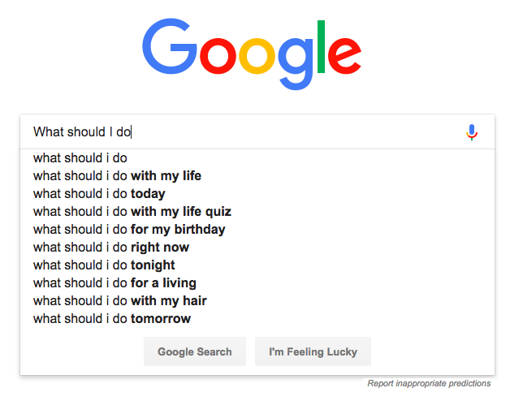
Solving the Problem
Indirect search
You don’t know what you want to search for
Interactive
Not a boring search and does the hard work for you by giving you a maps of locations and the weather.

Slide 4
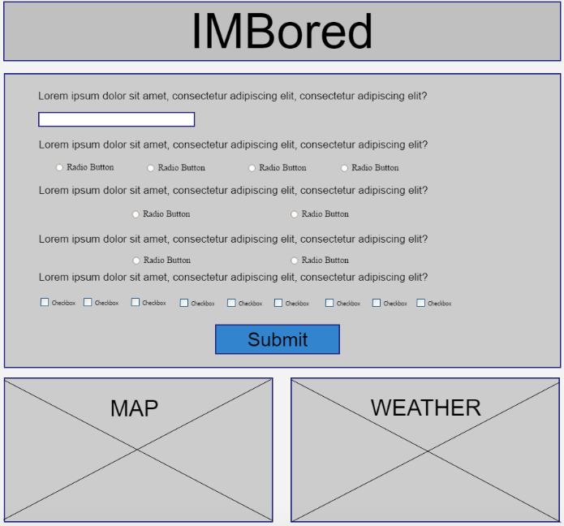
Steps
Creating Wireframe
Delegating Tasks
Front end
Bootstrap
Back end
API Keys: Google Maps + Open Weather
New Tech
Github
Collaborating

Slide 5
Final Result
Show the app running and solving the problem that began your story. Also talk about what features you’d like
Insert screenshots of working app
Survey feature
Map widget
Weather widget

Slide 6
Task
e. give a breakdown of the specific tasks that each person was in charge of.

Slide 7
Challenges
Finding a starting point
API keys
Delegating

Slide 8
Phase 2
Login
Itinerary
Add more parameters
Interests, how many people, etc.
Ticket purchase links

